Slide 1

Project 1
Group 4
Veronica Ostapowich
Britt Waggoner
Trevor Bridges
Zechariah Lau
Nou Yang

Slide 2
Description
Many people want to have excellent work-life balance. What information can be provided to help people shape their lives and maximize their overall life satisfaction?
Dataset: Survey responses from Authentic-Happiness.com that aimed to gauge how well people have work-life balance according to their lifestyle, habits, and behaviors.
Dataset from Kaggle
Authentic-Happiness Survey
Data Cleaning: The original dataset contains 15,000 responses from July 2015 – March 2021. Downsized by sampling only responses from March 2019 – March 2021 (5,548).

Slide 3
Research Questions
How do daily stress levels affect work-life balance?
Does supporting other people have an impact on achieving excellent work-life balance?
Are those who meditate weekly more likely to have better work-life balance than those who don’t?
If you spend time doing things you're passionate about daily, how does this change your work-life balance?
Does finishing Your To-Do List impact overall life satisfaction?

Slide 4

How do daily stress levels affect work-life balance?
Survey Question: How much stress do you typically experience everyday?
Stress at home
Environmental stress (e.g. noise, pollution, insecurity, etc.)
Stress at work (e.g. co-workers, boss, deadlines, etc.)
Traumatic events (e.g. divorce, job loss, serious illness, loss of family or friends, etc.)
Average over 12 months
Response options 0 through 5
Notes:
Trevor

Slide 5
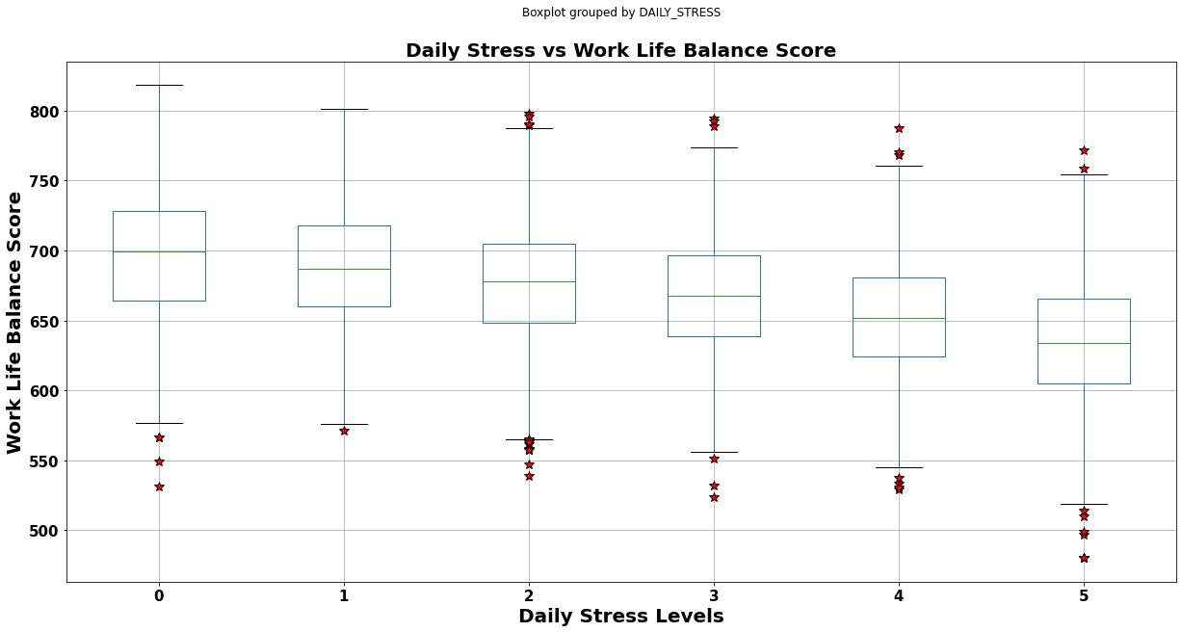
How do daily stress levels affect work-life balance?
Notes:
Trevor

Slide 6
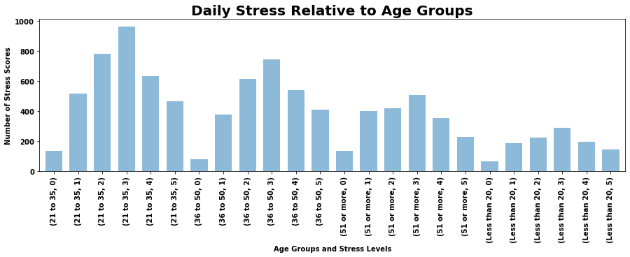
How do daily stress levels affect work-life balance?
Notes:
Trevor

Slide 7
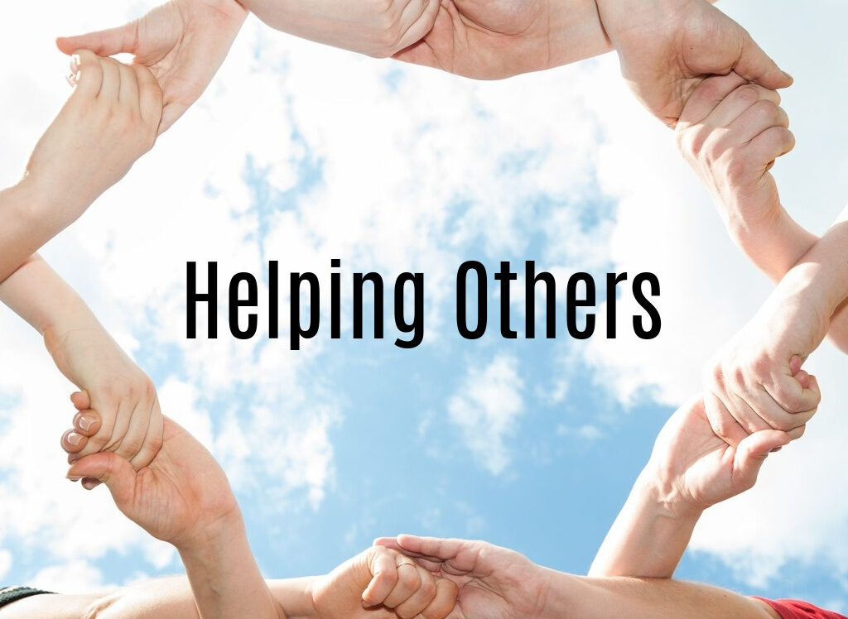
Does supporting other people have an impact on achieving excellent work-life balance?
Survey Question: How many people do you help achieve a better life?
A reflection of your altruism or selflessness
e.g.: caring for your family, actively supporting a friend, mentoring, coaching, developing or promoting a co-worker…
Over a period of 12 months
Response options 0 through 10
Notes:
Nou

Slide 8
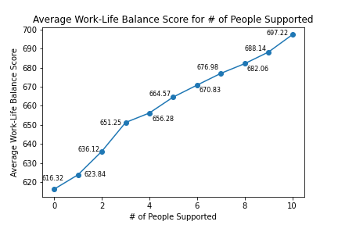
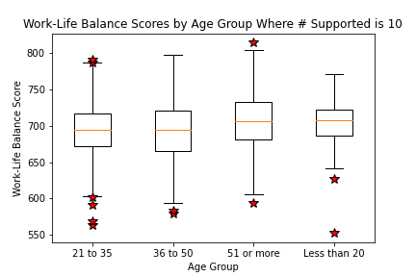
Does supporting other people have an impact on achieving excellent work-life balance?
Line chart of average work-life balance scores for the different numbers of people supported
Box plot of work-life balance scores across age groups for respondents reporting the number of people supported is 10
Notes:
Nou

Slide 9

Are those who meditate weekly more likely to have better work-life balance than those who don't?
Survey Question: In a typical week, how many times do you have the opportunity to think about yourself?
Include meditation, praying and relaxation activities such as fitness, walking a park or lunch breaks.
Response options 0 through 10.
Notes:
Veronica

Slide 10
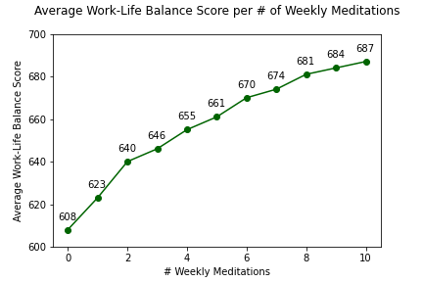
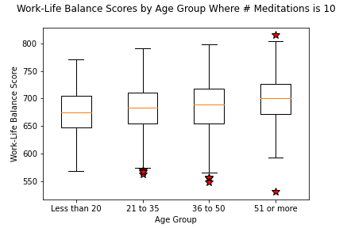
Are those who meditate weekly more likely to have better work-life balance than those who don't?
Line chart of average work-life balance scores per # of weekly meditations.
Box plot of work-life balance scores across age groups for individuals meditating 10 times weekly.
Notes:
Nou

Slide 11

How does making time for your passion affect your work- life balance score?
Survey Question: How many hours do you spend everyday doing what you are passionate about?
Daily hours spent doing what you are passionate and dreaming about, and/or contributing to a greater cause: health, education, peace, society development, etc.
Response options 0 through 10.
Notes:
Veronica

Slide 12
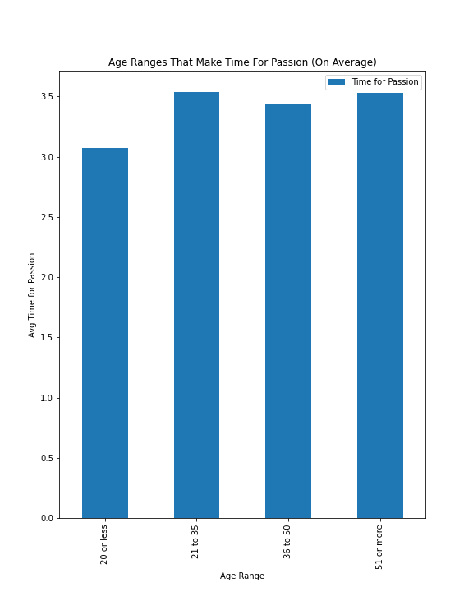
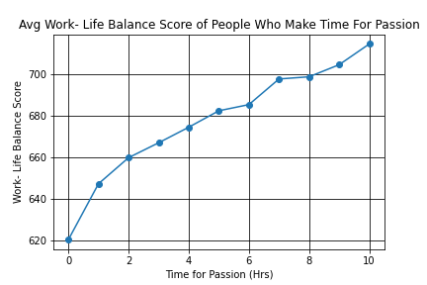
How does making time for your passion affect your work- life balance score?
Bar graph of average time spent on passions across different age groups.
Line graph of average time spent on passions and its affect on work- life balance scores.
Notes:
Britt

Slide 13
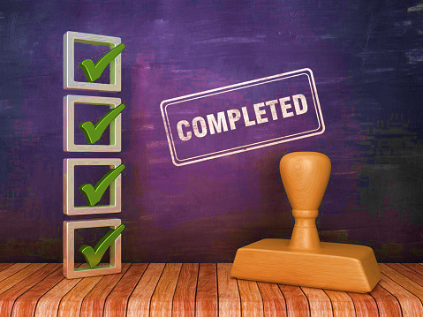
Does Finishing Your To-Do List impact overall life satisfaction?
Survey Question: How well do you complete your weekly To-Do lists?
Include your weekly goals, work- and personal-related tasks.
On a scale of 0 = not at all to
10 = very well.
Notes:
Veronica

Slide 14
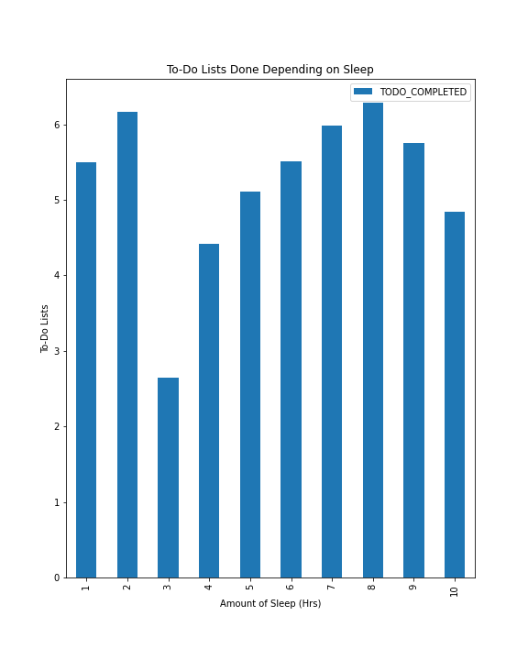
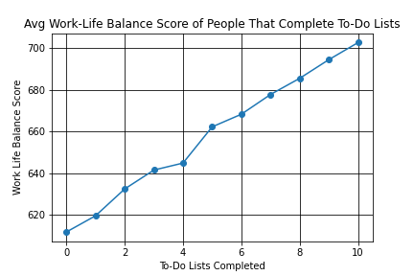
Does Finishing Your To-Do List impact overall life satisfaction?
L: Hours 1-3 will be thrown out due to them being outliers.
L: Shows that the golden sleep time is 7 or eight hours.
R: You can increase your Work-Life Balance score by 80+ points just by completing your daily tasks.
Notes:
Zac

Slide 15
Analysis and Conclusions
Daily Stress: Increased daily stress results in decrease work-life balance. Those younger than 20 and older than 51 years tend to carry less daily stress than their midlife counterparts. It’s especially important to be mindful and manage your stress between the ages of 21-50, with particular emphasis on the 21-35 years time frame.
Supporting Others: Yes, supporting and helping others does have an impact on achieving work-life balance. The more people respondents supported, the higher the work-life balance score. We can also conclude that those ages 51+ are more likely to support 10 people in a 12-month period and have better work-life balance.
Weekly Meditation: There is a parallel between our life and the practice of meditation or making time for ourselves. Our analysis demonstrated that the more times the individuals meditate weekly, the higher is their level of work-life-balance, regardless of their age.
Time for Passion: On average, age groups between 21 and 35, and over 51, make more time doing things they love. Those that make time for passions have a higher work- life balance score than those who make little to no time for passions. Therefore, making time to do those things you love has a greater influence on your work- life balance, and overall health.
To-Do Lists Completion: Finishing your tasks set by you can be difficult, but whenever you finish the majority of your task your work-life balance score will increase. Something that you can change to help increase your ability to finish your tasks (whether work or personal) is to get between seven and eight hours of sleep each night.

Slide 16
Overall Conclusion
Each of us have analyzed different facets of our lives, and how individuals will achieve higher work-life balance scores.
If we balance our stress levels, support others frequently, make time to meditate or take care of ourselves, including time for the things we are passionate about, and complete our own to-do lists, we will achieve a much higher work-life score.
Let’s remember, self-care is a priority, not a luxury.

Slide 17

THANK YOU

